Slide 1
Capstone Project Presentation
Evaluating alternative retail sites for a hobby shop in Vancouver

Slide 2
1. Introduction
Considering buying an existing model railroad hobby shop
May downscale the physical size of the store, move it to a lower rent area of town, and greatly enhance the online presence of the business
Need to evaluate alternative retail lease sites for the store

Slide 3
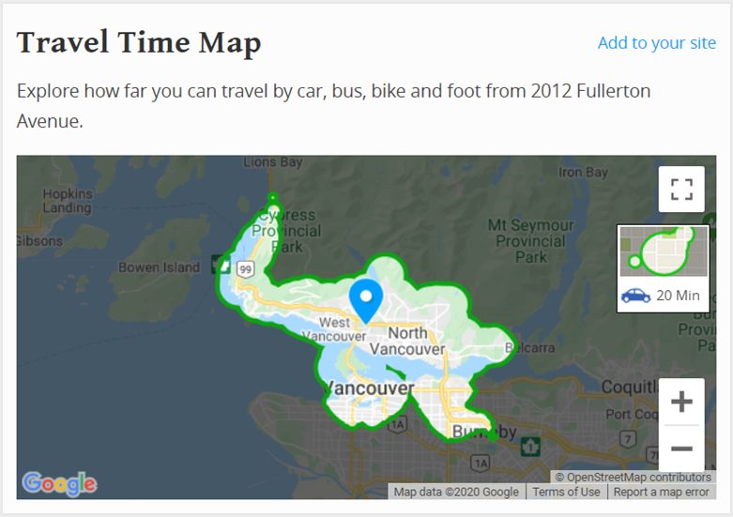
2. Data
Consider locations within 20 minutes drive of my home
Walk Score - https://www.walkscore.com

Slide 4
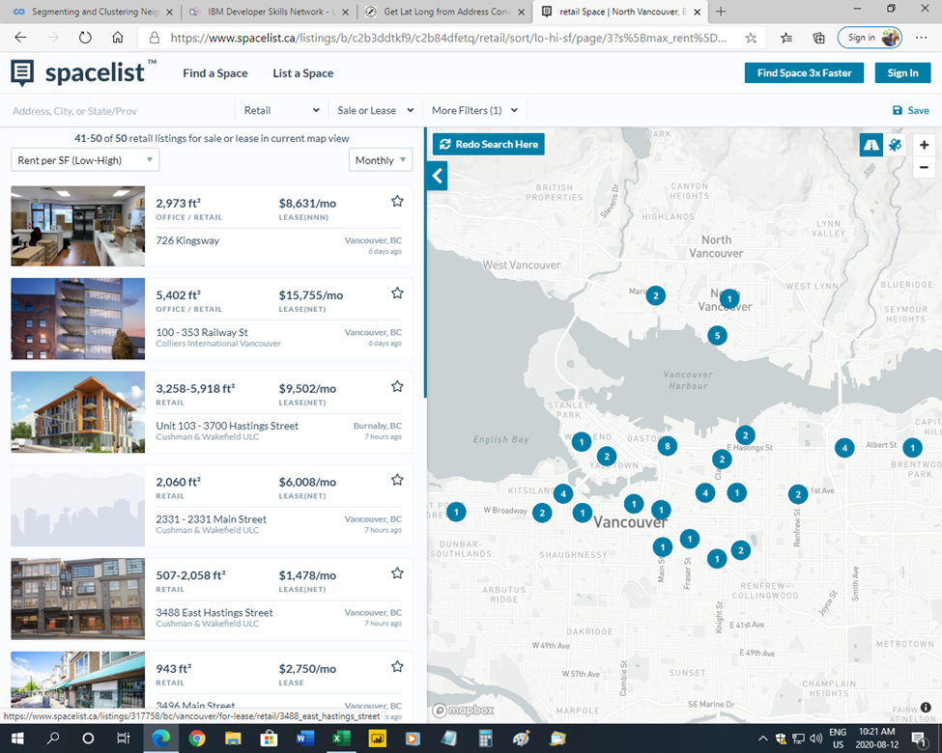
2. Data - Continued
Retail lease space listings
Filter < 20 minute drive
Filter < $35.00 sqft/yr
Current 51 sites for analysis
Spacelist - https://www.spacelist.ca

Slide 5
2. Data - Continued
Grab Latitude and Longitude coordinates of retail sites
Geocodio - https://dash.geocod.io
Grab nearby venue data
Foursquare - https://foursquare.com

Slide 6
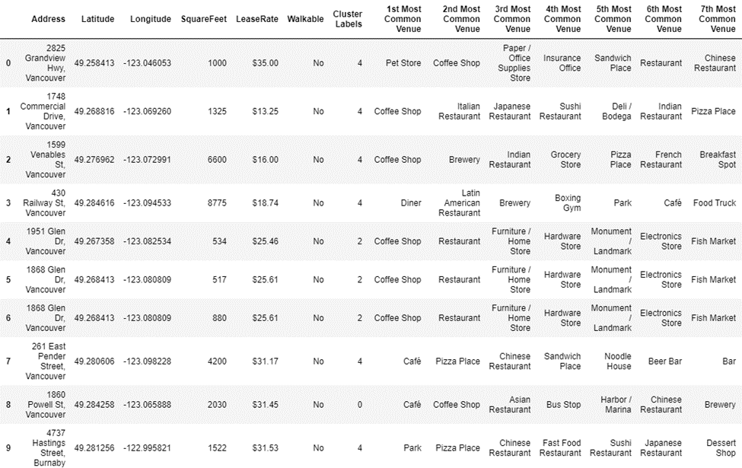
3. Method
K-means cluster analysis
Sites grouped into 5 clusters based on frequency of nearby venues

Slide 7
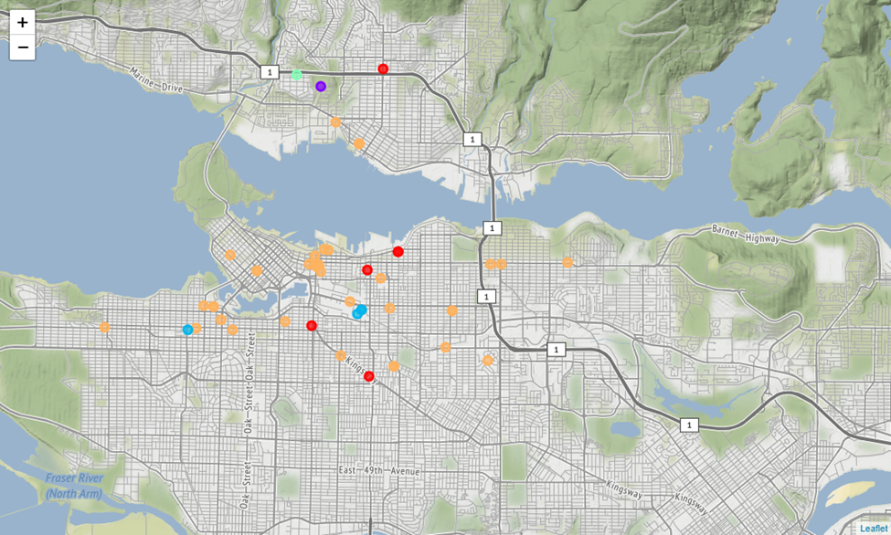
4. Results
Cluster #0 – red markers, 6 retail sites
Cluster #1 – purple marker, 1 retail site
Cluster #2 – blue markers, 4 retail sites
Cluster #3 – light blue marker, 1 retail sites
Cluster #4 – orange marker, 39 retail sites
2 sites within walking distance of home
(light blue and purple markers)

Slide 8
5. Discussion
Fair number of available retail sites for lease. More available if wanted to consider longer commutes (+20 minutes) or higher rent (+$35 sqft/yr)
Weigh sites located away from main retail shopping area - less foot traffic but lower lease rates
Weigh 2 walkable sites - great for me but may not be ideal for business
Impact of coronavirus on future lease availability and rates

Slide 9
6. Conclusion
Retail situation is currently very fluid
No need to make a decision on new lease location right away
Consider waiting to see how the retail market responds over next year

